Slide 1
Brazil's National Museum
What type of conclusions can we arrive from analyzing the fire of Brazil's National Museum?

Slide 2
What happened?
Brazil's National Museum was burned and destroyed; Meilan Solly of Smithsonian writes: "According to BBC's Brasil's Julia Carneiro some artifacts were successfully salvaged – zoologist Paulo Buckup, for one, managed to escape with a "few thousand" mollusk specimans..."
A local official speculated to the Guardian, a newspaper, that up to 90% of the museum's collections could have been destroyed by the flames. Investigators are still awaiting permission to assess the building's charred remains.

Slide 3
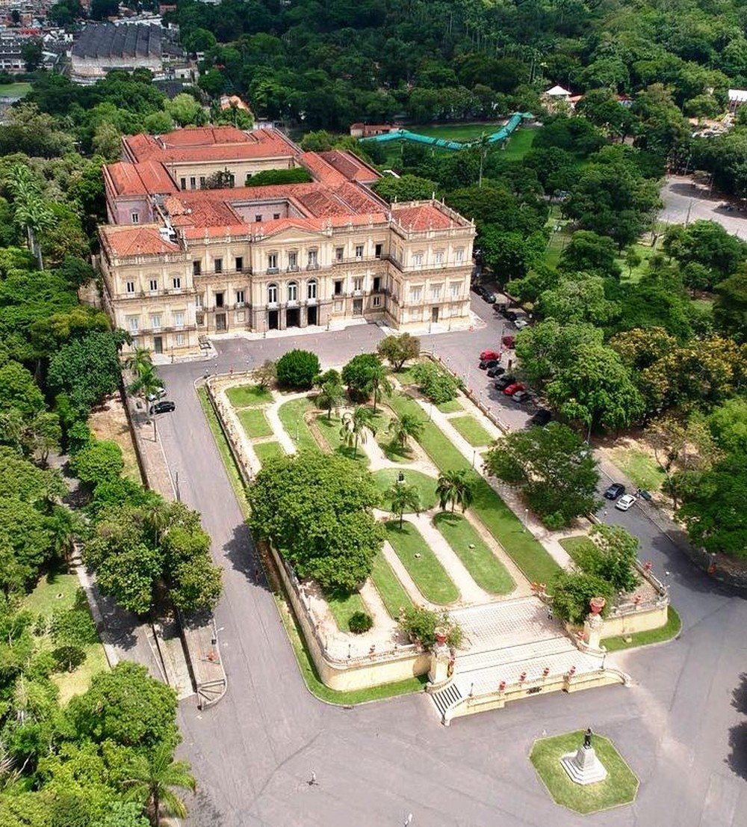
The National Museum the night before the fire
Source: Incunabula on Twitter @incunabula

Slide 4
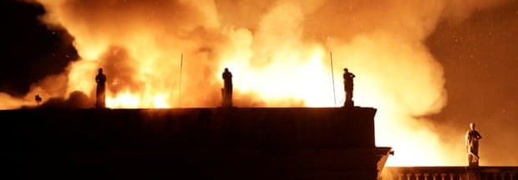
Photo of the Museum Fire
Source: Ricardo Moraes/Reuters

Slide 5
Additional Info
Two fire hydrants lacked the pressure to fight the flames. The fire department had to siphon water from a nearby lake.
Brazil's culture minister Sergio Sa Leitaro said that Brazil needed to take better care of its cultural heritage and museums and that the museum's problems were pilling over time
It is uncertain what caused the fire.
National Geographic's Michael Greshko writes since 2014 the museum has failed to receive an annual budget of 128,000. This year the museum received 13,000. Indigenous people have protested the government about the lack of funding for hydrant maintenance, yet funding for a new museum.
The museum was recently granted $5 million in funds, but it was set to arrive in October.

Slide 6
Conclusions
The government's ability to provide funding shows this was a lack of oversight.
This is an example of how problems need to be solved quickly. The museum was scheduled to receive a lot of funding it just didn't come in time and with exceptionally poor timing.

Slide 7
Citations
Solly, Meilan. “Why Brazil's National Museum Fire Was a Devastating Blow to South America's Cultural Heritage.” Smithsonian.com, Smithsonian Institution, 4 Sept. 2018, www.smithsonianmag.com/smart-news/artifacts-destroyed-brazil-devastating-national-museum-fire-180970194/.
Phillips, Dom. “Brazil Museum Fire: 'Incalculable' Loss as 200-Year-Old Rio Institution Gutted.” The Guardian, Guardian News and Media, 3 Sept. 2018, www.theguardian.com/world/2018/sep/03/fire-engulfs-brazil-national-museum-rio.

